Slide 1



Introduction to Woman Empowerment
Woman empowerment is the process of enabling women to have control over their lives and make impactful decisions. It involves fostering a sense of self-worth and confidence, and challenging societal norms to create equal opportunities for women in various spheres of life.
by anshu giri

Slide 2
Importance of Woman Empowerment in Society
Equality
Community Development
Empowering women leads to a more equal and just society, where everyone has the opportunity to thrive.
When women are empowered, communities benefit from their unique perspectives and contributions to decision-making.
Economic Growth
Social Progress
Empowering women in society contributes to economic growth and stability through increased workforce participation.
Women empowerment is crucial for overall social progress and the advancement of human rights for all.

Slide 3
Challenges Faced by Women
Gender-Based Discrimination
Unequal Access to Education
Healthcare Disparities
Women often face inadequate access to healthcare services, especially in rural and underserved areas.
Women often face discrimination in the workplace, receiving lower pay and fewer opportunities for career advancement.
Many girls around the world are denied access to education, limiting their opportunities for personal and professional development.
There are also issues related to reproductive health and maternal mortality rates.
Harassment and bias can create hostile work environments, making it challenging for women to thrive professionally.
Lack of educational resources and cultural barriers perpetuate this inequality.

Slide 4
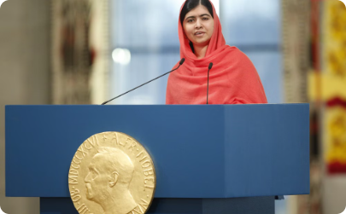
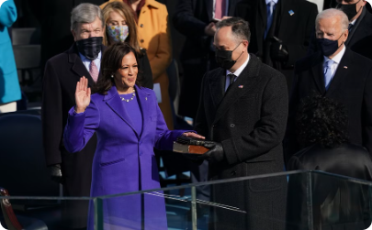

Achievements and success stories of empowered women
Malala Yousafzai
Kamala Harris
Serena Williams
At 17, the youngest Nobel Prize laureate, advocate for girls' education.
First female Vice President of the United States, breaking barriers.
Tennis champion, demonstrating resilience and strength in sports.

Slide 5

Role of Education in Empowering Women
Education plays a pivotal role in empowering women by providing them with knowledge and skills to confidently participate in economic, social, and political spheres.
Access to quality education equips women with the tools to challenge traditional gender norms, pursue leadership roles, and contribute meaningfully to their communities.
Furthermore, education fosters critical thinking and decision-making abilities, enabling women to advocate for their rights and strive for gender equality.

Slide 6

Economic Empowerment and Financial Independence for Women
1
Equal Pay and Opportunities
Advocating for fair wages and access to career advancement opportunities.
2
Entrepreneurship and Business Skills
Providing support for women to develop entrepreneurial skills and start their own businesses.
3
Access to Financial Resources
Ensuring women have equal access to financial services and resources for investment.

Slide 7



Breaking stereotypes and promoting gender equality
Gender Equality in Education
1
Equal access to educational opportunities
Workplace Equality
2
Equal pay and respect for women in the workforce
Challenging Gender Norms
3
Breaking traditional gender roles and expectations

Slide 8



Empowering Women in Leadership Roles
Mentorship
Networking
Skills Development
Mentoring programs for aspiring women leaders provide guidance and support.
Building strong professional networks opens doors for women in leadership positions.
Training and development programs enhance women's leadership skills and capabilities.

Slide 9

Support systems and organizations working for woman empowerment
Global Fund for Women
Vital Voices
This organization advocates for gender equality and supports women's rights movements worldwide.
They identify, invest in, and bring visibility to extraordinary women around the world.
CARE International
UN Women
CARE aims to fight global poverty and provide support and empowerment to women and girls.
The United Nations entity dedicated to gender equality and the empowerment of women.

Slide 10
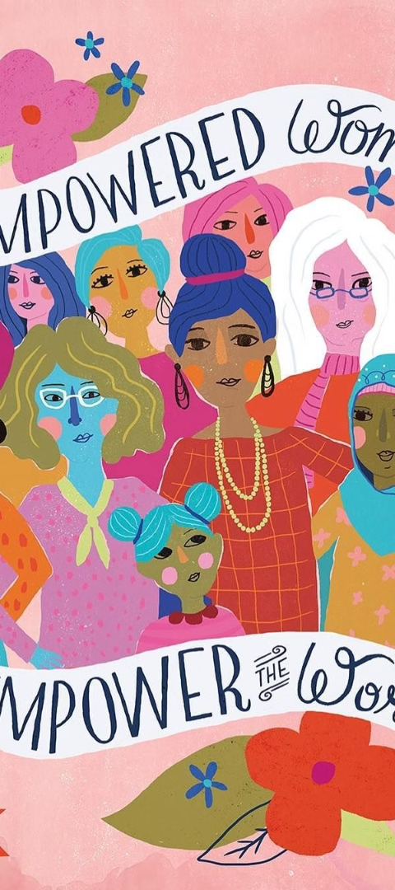



Conclusion and Call to Action for Promoting Woman Empowerment
Educate and Advocate
Support initiatives to educate about women's rights and advocate for gender equality.
Champion Equal Opportunities
Promote equal opportunities for women in the workplace and leadership positions.
Amplify Women's Voices
Encourage the amplification of women's voices in decision-making and policy formation.

Slide 11


